Slide 1
Noida Institute of Engineering and Technology, Greater Noida
Distributed Memory
Unit: III
High Performance Computing
Ms. Purnima Pal
Assistant Professor
Department of CSE-AIML
( B Tech 3rd Sem)

Slide 2

Faculty Profile
FACULTY PROFILE
Name of Faculty: Ms. Purnima Pal
Designation & Department: Assisstant Professor , CSE-AIML Dept.
Qualification: B.Tech , MTech & Pursuing PhD
Experience: Have 6 years experience of Teaching subjects such as, DLD and software Engineering.

Slide 3


Evaluation Scheme
B.Tech. (Computer Science CS)
Core subject
3rd SEMESTER
PREDICTIVE ANALYTICS

Slide 4

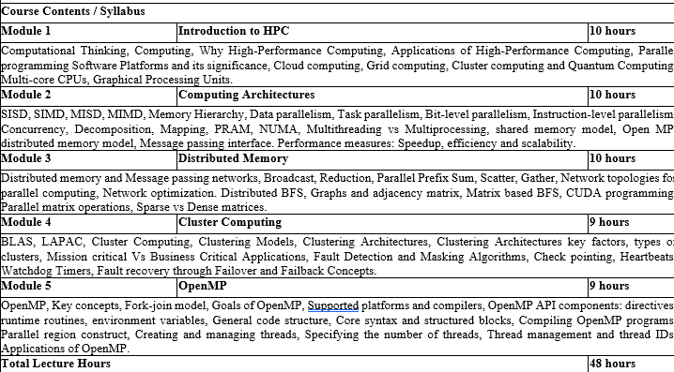
Course Contents / Syllabus

Slide 5
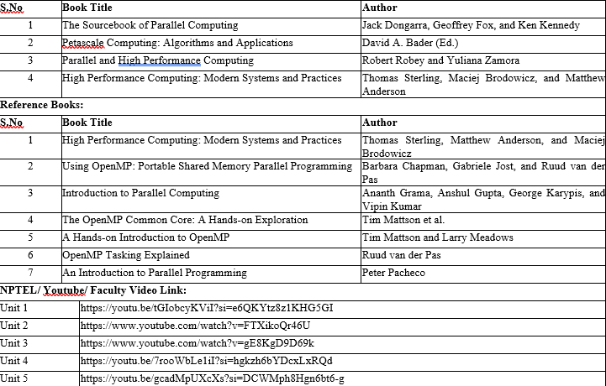
Book Title/ External Links as per Syllabus

Slide 6

Branch wise Applications
Computer science encompasses a diverse array of specialized fields that address modern technological challenges and innovations. Artificial Intelligence (AI) & Machine Learning (ML) empower systems to perceive, learn, and make decisions—from voice assistants and medical diagnostic tools to autonomous vehicles . Data Science & Big Data blend statistics, data modeling, and programming to uncover insights for business intelligence, fraud detection, and predictive analytics. Software Engineering focuses on the full lifecycle of building robust applications—from mobile and web platforms to enterprise and industrial systems . In Cybersecurity & Cryptography, specialists design secure protocols and systems to protect networks, financial infrastructure, and sensitive personal data. Cloud Computing & DevOps enable scalable on-demand services, powering online gaming, streaming, and enterprise applications with automated deployment pipelines . Fields like Computer Graphics & Visualization, Computer Vision, and HCI focus on visual, interactive, and user-centric computing, driving VR/AR, gaming, medical imaging, and intuitive interfaces. Algorithms & Data Structures form the theoretical backbone, optimizing search, encryption, and data retrieval while informing compiler and database design. At the hardware level, Computer Architecture & Embedded Systems support IoT, smart devices, and robotics through efficient design of processors and sensors . Blockchain & Distributed Systems revolutionize secure, decentralized applications in finance and supply chains. Emerging areas like Quantum Computing and Neuromorphic/Biological Computing promise breakthroughs in simulation, optimization, and ultra-efficient intelligent systems—whether using qubits to accelerate drug discovery or neuronal circuits to mimic brain-like computation .

Slide 7
Branch wise Applications
Computer science encompasses a diverse array of specialized fields that address modern technological challenges and innovations. Artificial Intelligence (AI) & Machine Learning (ML) empower systems to perceive, learn, and make decisions—from voice assistants and medical diagnostic tools to autonomous vehicles . Data Science & Big Data blend statistics, data modeling, and programming to uncover insights for business intelligence, fraud detection, and predictive analytics. Software Engineering focuses on the full lifecycle of building robust applications—from mobile and web platforms to enterprise and industrial systems . In Cybersecurity & Cryptography, specialists design secure protocols and systems to protect networks, financial infrastructure, and sensitive personal data. Cloud Computing & DevOps enable scalable on-demand services, powering online gaming, streaming, and enterprise applications with automated deployment pipelines . Fields like Computer Graphics & Visualization, Computer Vision, and HCI focus on visual, interactive, and user-centric computing, driving VR/AR, gaming, medical imaging, and intuitive interfaces. Algorithms & Data Structures form the theoretical backbone, optimizing search, encryption, and data retrieval while informing compiler and database design. At the hardware level, Computer Architecture & Embedded Systems support IoT, smart devices, and robotics through efficient design of processors and sensors . Blockchain & Distributed Systems revolutionize secure, decentralized applications in finance and supply chains. Emerging areas like Quantum Computing and Neuromorphic/Biological Computing promise breakthroughs in simulation, optimization, and ultra-efficient intelligent systems—whether using qubits to accelerate drug discovery or neuronal circuits to mimic brain-like computation .

Slide 8
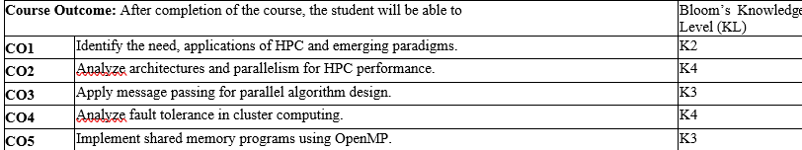
Course Outcomes
Course Outcome
At the end of the Course, the student will be able

Slide 9
Course Objective(Module -3)
Implement distributed memory techniques and message passing for parallel algorithm design.

Slide 10
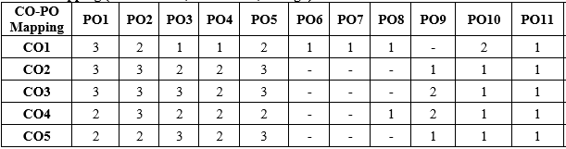
CO-PO Mapping
CO-PO Mapping
CO-PO Correlation Matrices
Correlation levels are taken 1, 2 and 3 as defined below:
1: Slight (Low) 2: Moderate (Medium) 3: Substantial (High)

Slide 11
CO-PO and PSO Mapping
Program Specific Outcomes and Course Outcomes Mapping
 | PSO1 | PSO2 | PSO3 | PSO4
Module 1 | 3 | 3 | 3 | 3
Module 2 | 3 | 3 | 3 | 3
Module 3 | 2 | 2 | 2 | 2
Module 4 | 3 | 3 | 3 | 3
Module 5 | 2 | 2 | 2 | 2
Average | 2.6 | 2.6 | 2.6 | 2.6
*3= High *2= Medium *1=Low

Slide 12
Topic mapping with CO
Topic | CO
Distributed memory and Message passing networks | CO3
Broadcast | CO3
Reduction | CO3
Parallel Prefix Sum | CO3
Scatter | CO3
Gather | CO3
Network topologies for parallel computing | CO2
Network optimization | CO2
Distributed BFS | CO3
Graphs and adjacency matrix | CO2
Matrix based BFS | CO3
CUDA programming | CO2
Parallel matrix operations | CO3
Sparse vs Dense matrices | CO2

Slide 13
Program Specific Outcomes (PSOs)
PSO’s
At the end of the program, the student will be able to-
PSO 1: Apply suitable techniques, modern tools to solve complex engineering problems in the field of computer science.
PSO 2: Design and optimize, ethical and innovative solutions for the betterment of the society.
PSO 3: Work as an individual or lead in a team with good communication and engage in life-long learning.

Slide 14
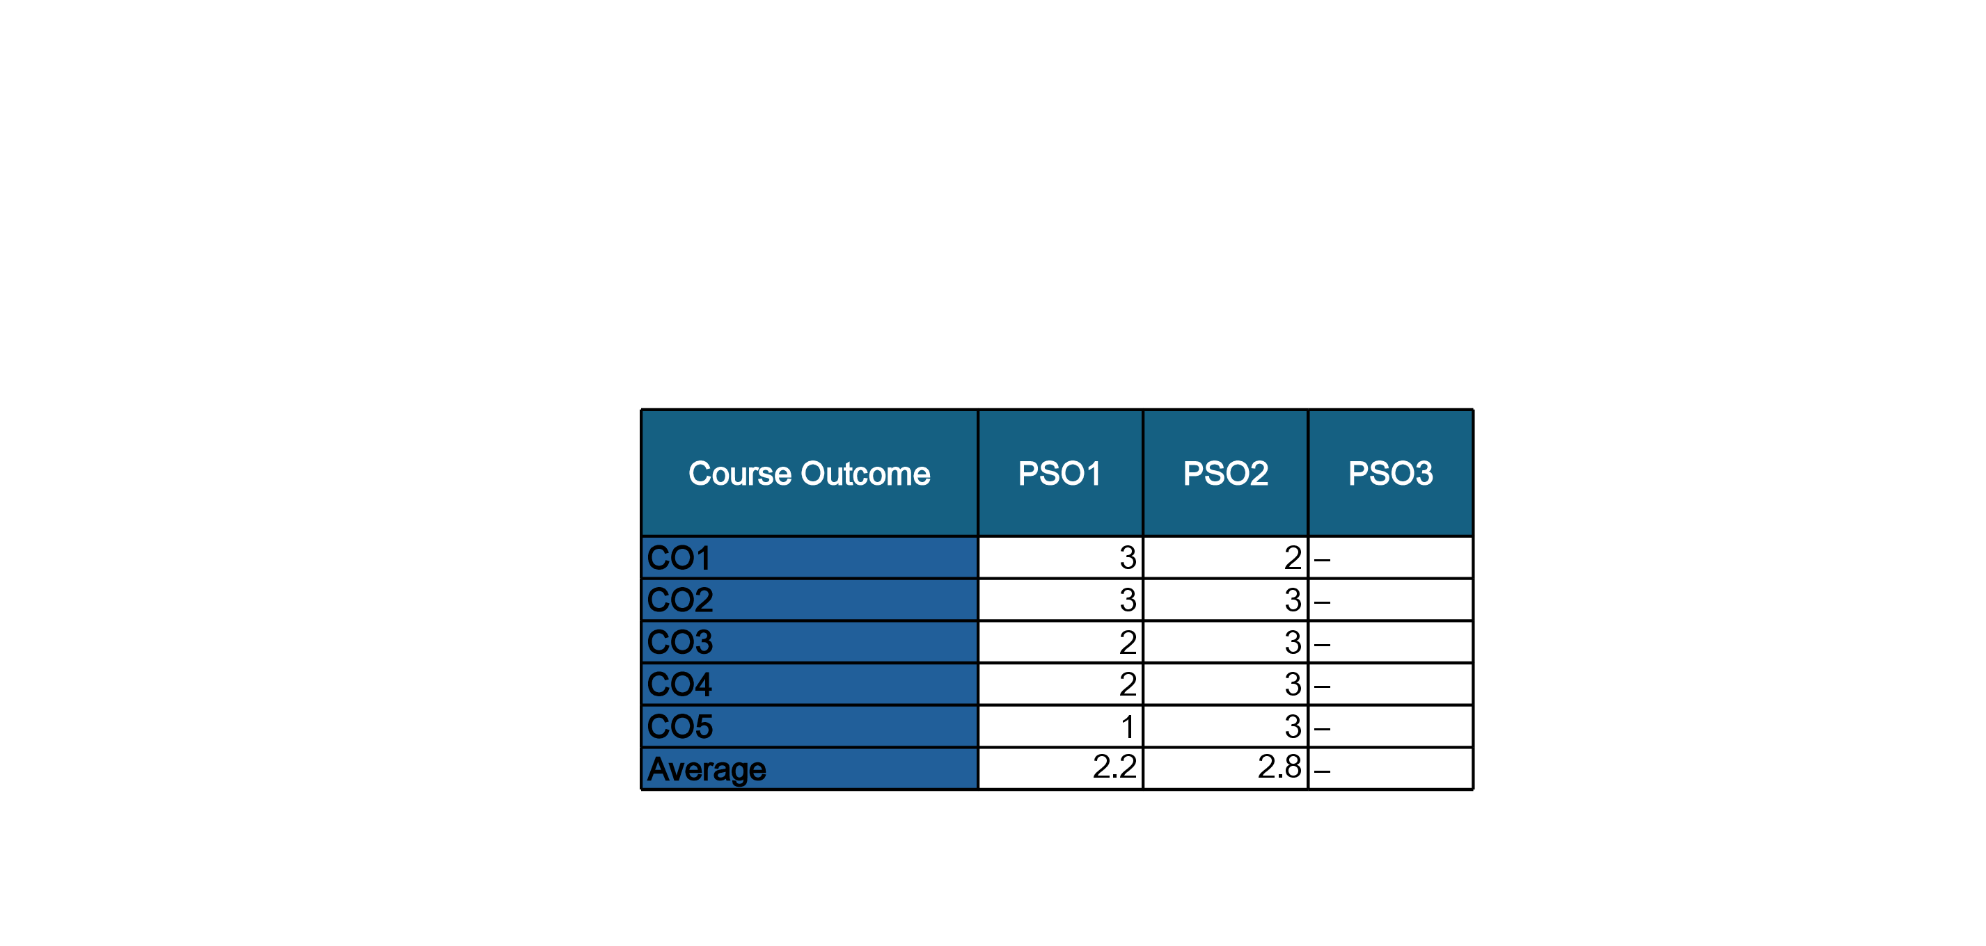
COs and PSOs Mapping

Slide 15
Program Educational Objectives (PEOs)
PEO’s
The graduates of B.Tech Computer Science program will-
PEO1: Have successful careers in the field of Computer Science and pursue higher education.
PEO2: Engage in research and provide innovative solution to real world problems of the society with ethical responsibilities.
PEO3: Demonstrate effective communication, work as an individual or as a team and engage in life-long learning.

Slide 16


Question Paper Template

Slide 17
Question Paper Template
 |  | SECTION – A |  | CO
 | Attempt all parts- |  | [10×1=10]
 | 1-a. | Question- | (1)
 | 1-b. | Question- | (1)
 | 1-c. | Question- | (1)
 | 1-d. | Question- | (1)
 | 1-e. | Question- | (1)
 | 1-f. | Question- | (1)
 | 1-g. | Question- | (1)
 | 1-h. | Question- | (1)
 | 1-i. | Question- | (1)
 | 1-j. | Question- | (1)
2. | Attempt all parts- |  | [5×2=10] | CO
 | 2-a. | Question- | (2)
 | 2-b. | Question- | (2)
 | 2-c. | Question- | (2)
 | 2-d. | Question- | (2)
 | 2-e. | Question- | (2)
SECTION – B |  |  |  | CO
3. | Answer any five of the following- |  | [5×6=30]
 | 3-a. | Question- | (6)
 | 3-b. | Question- | (6)
 | 3-c. | Question- | (6)
 | 3-d. | Question- | (6)
 | 3-e. | Question- | (6)
 | 3-f. | Question- | (6)
 | 3-g. | Question- | (6)
SECTION – C |  |  |  | CO
4 | Answer any one of the following- |  | [5×10=50]
 | 4-a. | Question- | (10)
 | 4-b. | Question- | (10)
5. | Answer any one of the following-
 | 5-a. | Question- | (10)
 | 5-b. | Question- | (10)
6. | Answer any one of the following-
 | 6-a. | Question- | (10)
 | 6-b. | Question- | (10)
7. | Answer any one of the following-
 | 7-a. | Question- | (10)
 | 7-b. | Question- | (10)
8. | Answer any one of the following-
 | 8-a. | Question- | (10)
 | 8-b. | Question- | (10)

Slide 18
Result Analysis
Subject Result: NA
Department Result: NA
Faculty-Wise Result: NA

Slide 19
Prerequisite and Recap
Basic Programming Skills: Proficiency in C/C++ with good understanding of arrays, loops, functions, and pointers.
Data Structures & Algorithms: Knowledge of matrices, graphs (especially BFS), and operations like traversal and adjacency matrix representation.
Computer Architecture & OS Concepts: Familiarity with processor architecture, memory hierarchy, and concepts like processes, threads, and inter-process communication.

Slide 20
Brief Intro of Subject with video
High Performance Computing (HPC) focuses on solving complex computational problems using parallel and distributed computing technologies. In today’s era of large-scale data and simulation-driven systems, HPC enables faster processing and analysis by harnessing the power of modern hardware and software tools like multi-core processors, clusters, grids, and even quantum systems.
Students learn:
Core concepts of parallelism
Architectural models like SIMD, MIMD
Programming using OpenMP and MPI
Fault-tolerant mechanisms in cluster systems
This course builds the foundation to design, implement, and analyze performance-driven software and systems used in scientific research, machine learning, big data, etc.
Topic-wise Video Lectures (YouTube/NPTEL)
Unit 3 Disttibuted Memory: https://www.youtube.com/watch?v=gE8KgD9D69k

Slide 21
Distributed memory
Distributed memory refers to a type of computer architecture where each processor (or computing node) has its own private memory. Unlike shared memory systems, where all processors access a common memory space, in distributed memory systems, no processor can directly access the memory of another processor.
In distributed memory systems, each processor has its own local memory. Processors communicate by passing messages over a network. This is common in clusters of machines.
How It Works: Each node (or processor) works independently and stores its own data locally. If a node needs data stored in another node’s memory, it cannot access it directly — instead, it must explicitly communicate with that node using a communication protocol (like MPI).
Advantages:
Scalability: Systems can be scaled easily by adding more nodes.
Reduced Memory Bottlenecks: Since each processor accesses its own memory, there's less contention.
High Bandwidth: Local memory access is faster, enabling high-speed computations.

Slide 22
Message passing networks
Software Design
Message passing is a communication model used in distributed memory systems where processes exchange information by sending and receiving messages. Since there’s no shared memory, this model is essential for cooperation among distributed processes.
Each process in a message-passing system:
Manages its own local state and execution context.
Communicates using a message-passing interface (such as MPI).- Message Passing Interface (MPI) is a standard model for programming distributed memory systems. It allows processes to exchange data through messages, supporting operations like send/receive and collective communications.
Does not share variables with other processes — all data is transferred via messages.

Slide 23
Distributed memory Vs Message passing networks,
Software Design
Distributed Memory | Message Passing Networks
A computer architecture where each processor has its own local memory. | A communication model where processes exchange data via messages.
Hardware architecture | Software/communication model
No shared memory; memory is local to each processor. | No shared memory; communication happens through message exchange.
To physically separate memory for scalability and parallelism. | To enable cooperation and data exchange in distributed systems.
Requires message passing for data exchange between processors. | Implements the actual communication (send/receive) between processes.
Cluster computing, supercomputers with local node memory | MPI (Message Passing Interface), PVM, sockets
Deals with how memory is structured in a system | Deals with how data is communicated between processes
Used in systems needing scalability and high performance | Used in programming such systems for coordination and data exchange

Slide 24
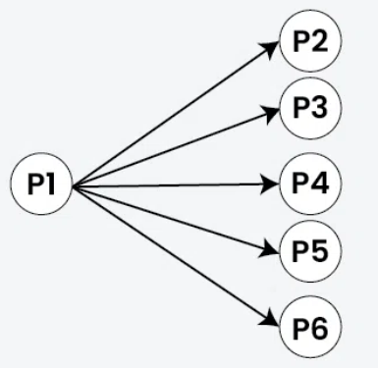
Broadcast in Distributed Systems
Software Design
In distributed systems, broadcast refers to a communication method where a single message is sent from one node to all other nodes in the system. This is crucial for various tasks like disseminating information, coordinating actions, and maintaining consistency across multiple machines. There are different types of broadcast, each with varying guarantees about message delivery and ordering.
The Purpose of Broadcast is used to efficiently distribute data or control messages to all participants in a distributed system.

Slide 25
Type of Broadcast
Software Design
Types: Broadcast can be categorized based on the guarantees it provides:
Best-effort broadcast: A message is sent to all nodes, but delivery is not guaranteed.
Reliable broadcast: Ensures that all correct nodes receive the message.
Atomic broadcast: Guarantees that either all correct nodes receive the message, or none do, and that they all receive it in the same order.
Causal broadcast: Delivers messages in a causal order, preserving the order of events.
Total order broadcast: Ensures that all nodes deliver messages in the same total order.

Slide 26
Applications of Broadcast
Software Design
Coordination: Broadcast is used to synchronize nodes and coordinate actions in distributed algorithms.
Consistency: It helps maintain data consistency across multiple nodes by ensuring everyone receives updates.
Fault Tolerance: Reliable and atomic broadcast protocols are essential for building fault-tolerant systems.
Data Distribution: Broadcast can be used to distribute data to all nodes in a system efficiently.

Slide 27
Reduction
Software Design
In distributed memory systems, a reduction operation is used to combine data from multiple processing units into a single result. This is often necessary in parallel computing where different parts of a calculation are performed on separate processors, and the final result requires aggregating the individual outputs. Common examples include summing a list of numbers, finding the minimum or maximum value, or performing a logical AND/OR operation across distributed data.
How Reduction Works in Distributed Memory:
1. Data Distribution:
The initial dataset is divided and distributed across multiple processors, each with its own local memory.
2. Local Computations:
Each processor performs the desired operation on its local subset of the data, producing a partial result.
3. Reduction Phase:
The processors then participate in a reduction operation, where they exchange and combine their partial results to arrive at the final, global result.
4. Result Distribution:
The final result may then be distributed back to all or some of the processors, or it may only be needed by a single process.

Slide 28
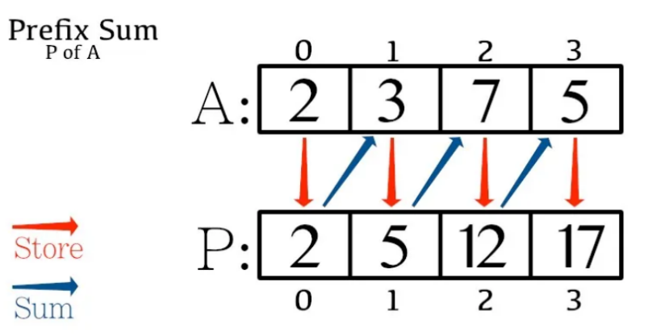
Prefix Sum
Software Design
Prefix sum is the cumulative sum of all the previous occurred elements with the current element.
Given,
An array A: [2, 3, 7, 5],
Now, let’s try to find the prefix sum of A.
Let’s define the output array as P. Array P for each index contains sum of all the previously occurred elements. We can use a loop where we add the previous element to the current element throughout the array.

Slide 29
Prefix Sum
Software Design
pseudo-code for the given:
// We define an array A A = [2, 3, 7, 5] P = A.copy() // P is a copy of elements of A // We use a loop to iterate through the array P and add the previous element to the current one for(int i=1; i<P.length(); i++){ P[i] = P[i] + P[i-1] }
So,
P[0] = A[0], P[1] = A[0] + A[1], P[2] = A[0] + A[1] + A[2], P[3] = A[0] + A[1] + A[2] + A[3]

Slide 30
Prefix Sum
Software Design
Therefore,
P[0] = 2, // The first element is 2, so, P[0] = 2
P[1] = 2 + 3 = 5, //The second element is 1, so, P[1] = 2 + 3; which adds up to 5 and replaces the original position in the array
P[2] = 5 + 7= 12, //The third element is 7, and the sum of first two elements is stored in P[1] but the first two are stored in P[1], so P[2] = P[2] + P[1] = 7 + 5; so, not P[2] is updated to 12
P[3] = 12 + 5 = 17 //The fourth element is 5, and the sum of first three elements is stored in P[2] but the first three are already stored in P[2], so P[3] = P[3] + P[2] = 5 + 12; so, not P[3] is updated to 17
Hence, the new, updated array is [2, 5, 12, 17].

Slide 31
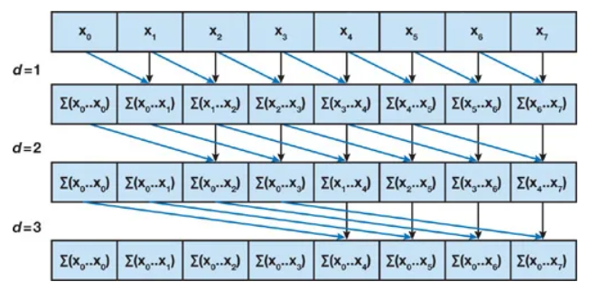
Parallel Prefix Sum Algorithm
Software Design
Here, in pairs of two, every element is added and then stored on to the latter one of the two taken. Then the header is moved on and now, every second elements are added on gaps of two from the original array that was changed. Then the header is moved and added on gaps of three. This computation is performed log2n number of times; where;
n = number of elements in the array

Slide 32
Software Design
Scatter
Gather and scatter are two fundamental data-parallel operations.
Gather
It is a type of memory addressing that collects or gathers data from multiple arbitrary indices, or, in simpler terms multiple given locations.
Pseudocode for gather;
for(int i=0; i<n; ++i){
x[i] = y[idx[i]]
}

Slide 33
Scatter
Software Design
It is a type of memory addressing that stores or scatters data from multiple arbitrary indices, or, in simpler terms multiple given locations.
Pseudocode for scatter;
for(int i=0; i<n; ++i){
y[idx[i]]<x[i]
}

Slide 34
Software Design
Network topologies for parallel computing,
Physical or logical. It affects how the communication between processes happens.
Ring or linear (chain)
Star
Mesh
Balanced binary tree
Hypercube
Torus, butterfly, dragonfly

Slide 35
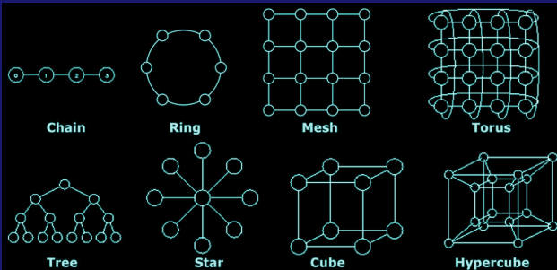
Parallel Networks Topologies
Software Design

Slide 36
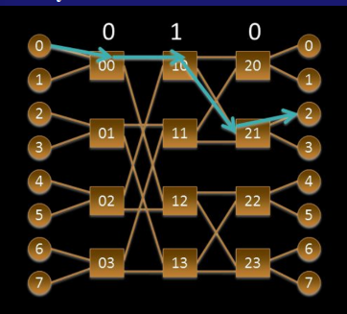
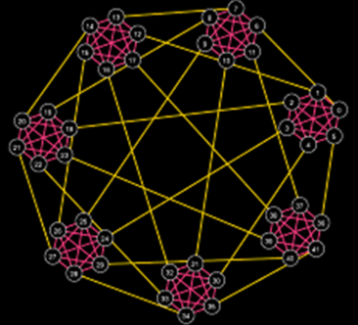
Butterfly and Dragonfly
Software Design
Butterfly Dragonfly

Slide 37
Network optimization
Software Design
Network optimization in distributed memory systems focuses on improving communication performance between nodes that have their own local memory. This is crucial for achieving high efficiency and scalability in parallel and distributed computing environments. Key strategies include optimizing data transfer, minimizing latency, and efficiently distributing workloads.
Network optimization techniques in distributed memory:
1. Data Partitioning and Distribution:
Sharding:
Dividing large datasets into smaller, manageable chunks (shards) that are distributed across different nodes. This ensures that each node works on a subset of the data, reducing the amount of data that needs to be transferred over the network.
Replication:
Creating multiple copies of data on different nodes to improve data availability and reduce latency for read operations.
Consistent Hashing:
Distributing data across nodes in a way that minimizes data redistribution when nodes are added or removed from the system, maintaining data consistency.

Slide 38
Network optimization
Software Design
Communication Optimization:
Message Passing Interface (MPI):
A standard for writing parallel programs that allows processes to communicate and synchronize with each other. Optimizing MPI communication patterns (e.g., reducing communication volume, using collective operations) can significantly improve performance.
Remote Direct Memory Access (RDMA):
Allows one node to directly access the memory of another node without involving the CPU of the remote node. This can significantly reduce latency and improve throughput for data transfers.
Network-on-Chip (NoC):
Integrated circuits that implement the communication network within a single chip, offering low latency and high bandwidth for data transfer between cores. NoCs are becoming increasingly important in multi-core and many-core processors.
Data Compression:
Compressing data before transmission can reduce the amount of data that needs to be transferred, leading to faster transfer times, especially for large datasets.
Caching:
Utilizing caching mechanisms on nodes can reduce the need to access remote data, minimizing network traffic and latency. This can involve caching data in local memory or on faster storage devices like SSDs.

Slide 39
Network optimization
Software Design
Load Balancing:
Distributing workloads evenly:
Distributing tasks across nodes to prevent any single node from becoming a bottleneck. This ensures that all nodes are utilized efficiently, maximizing overall system throughput.
Dynamic load balancing:
Adjusting the distribution of tasks dynamically based on the current workload of each node. This can involve moving tasks between nodes to balance the load as needed.
Addressing Security Concerns:
Secure Distributed Algorithms:
Developing algorithms that can operate in a distributed manner while protecting sensitive data from eavesdropping or tampering.
Secure Multiparty Computation (MPC):
Allows multiple parties to jointly compute a function over their inputs while keeping those inputs private. This can be useful in distributed systems where data needs to be processed by multiple parties without revealing the data to each other.

Slide 40
Network optimization
Software Design
Tools and Technologies:
MooseFS:
A distributed file system that utilizes idle memory on compute nodes to improve memory utilization.
RDMA Buffer Pool (RBP):
Optimizes network performance for in-memory file systems by leveraging RDMA technology.
Spark:
A popular framework for distributed computing that includes various optimization techniques for in-memory data processing, including caching and shuffling.
Kubernetes:
An open-source container orchestration system that can be used to manage and scale distributed applications, including those that utilize distributed memory.
Network monitoring and analysis tools:
Used to identify bottlenecks and optimize network performance.

Slide 41
Distributed BFS
Software Design
Distributed BFS is used to process large graphs efficiently, especially for finding shortest paths and detecting communities in networks.
It starts from a source vertex and explores the graph level by level using Breadth-First Search until all reachable vertices are visited.
The traversal order helps identify shortest paths between node pairs.
While there are many versions, the classic algorithm by Leskovec et al. is widely referenced.
Distributed BFS has practical applications in social networks (e.g., Twitter, Facebook), routing, and grid scheduling.
Compared to other graph algorithms like PageRank, distributed BFS is simple to implement and efficient in time and space.
It often finds shorter paths than alternative algorithms due to its systematic exploration.

Slide 42
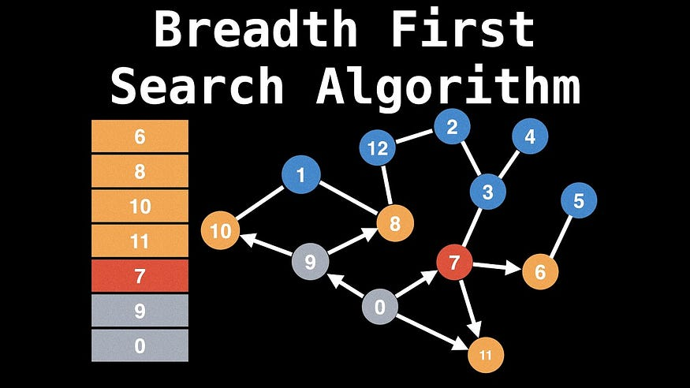
Distributed BFS
Software Design

Slide 43
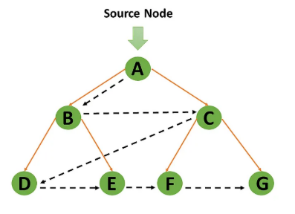
Software Design
Working Of The Distributed BFS Algorithm

Slide 44
Software Design
Working Of The Distributed BFS Algorithm
the distributed BFS algorithm proceeds as follows:
1) Each node is assigned a unique ID.
2) A random node is chosen as the root node. This node initiates the BFS process by sending a message to all its neighbour’s, requesting that they provide their ID.
3) Upon receiving the IDs from its neighbour’s, the root node computes the shortest paths from itself to all other nodes using the IDs and creates a tree. The tree is then broadcast to all nodes in the network.
4) Each node receives the tree and sets its own ID as the parent of all nodes in its subtree.
5) The process continues until all nodes have been visited. The main advantage of the distributed BFS algorithm is that it is scalable and can be used to find the shortest path in large networks. The main disadvantage of the distributed BFS algorithm is that it requires a lot of communication between nodes, which can be costly.

Slide 45
Advantages Of Distributed BFS Algorithm
Software Design
There are several advantages to using a distributed breadth-first search (BFS) algorithm over a traditional BFS algorithm. Some of these advantages include:
Improved scalability: A distributed BFS algorithm can be run on a distributed system, such as a cluster of computers or a network of machines, allowing it to handle larger datasets more efficiently than a traditional BFS algorithm.
Better performance: Because a distributed BFS algorithm can take advantage of the parallel processing capabilities of a distributed system, it can often complete its search more quickly than a traditional BFS algorithm.
Enhanced fault tolerance: In a distributed system, if one of the nodes fails or goes offline, the other nodes can continue to operate, ensuring that the search is not interrupted. This can be especially useful in mission-critical applications, where it is important to ensure that the search is completed even in the face of failures.
Increased flexibility: A distributed BFS algorithm can be easily adapted to handle different types of graphs and data structures, allowing it to be used in a wide variety of applications.
Better utilization of resources: In a distributed system, each node can operate independently, allowing for the efficient use of resources such as memory and CPU time. This can lead to better overall performance and cost savings compared to a traditional BFS algorithm.

Slide 46
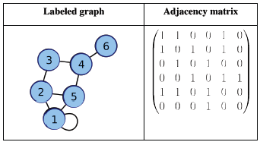
Graph and Adjacency Matrix
Software Design

Slide 47
Software Design
Graph and Adjacency Matrix
A graph is a data structure that consists of a set of vertices (or nodes) and a set of edges that connect these vertices. Each edge has a direction and a weight, which represent the relationship between the two vertices it connects. For example, a social network can be represented as a graph, where the vertices represent the users and the edges represent the connections between them.
An adjacency matrix is a square matrix that is used to represent a finite graph. The size of the matrix is equal to the number of vertices in the graph, and the entries in the matrix indicate whether there is an edge between two vertices or not.

Slide 48
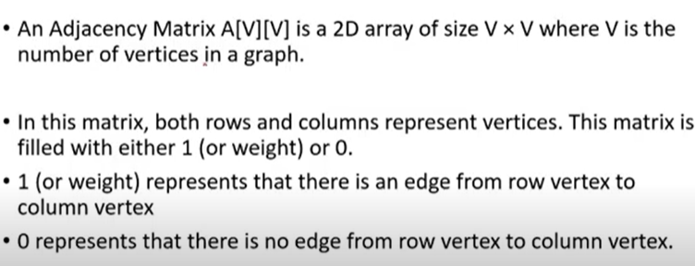
Adjacency Matrix
Software Design

Slide 49
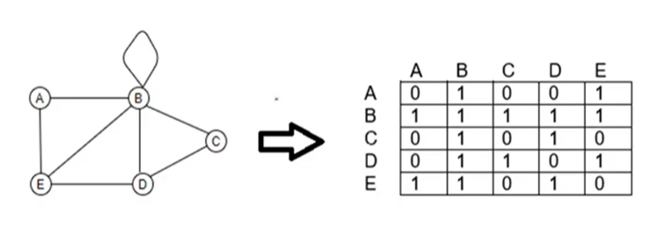
Adjacency Matrix for Undirected Graph
Software Design

Slide 50
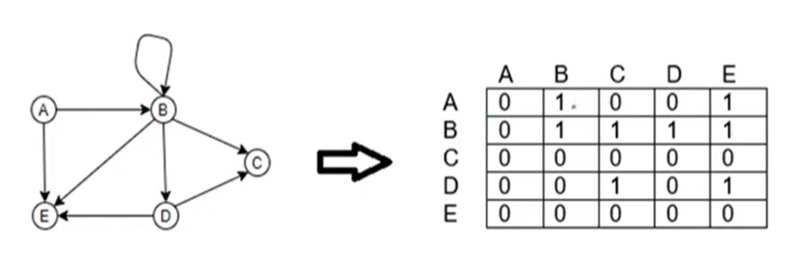
Adjacency Matrix for Directed Graph
Software Design

Slide 51
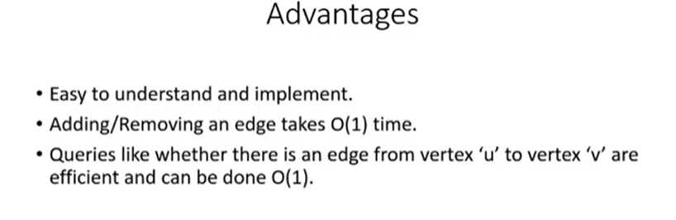
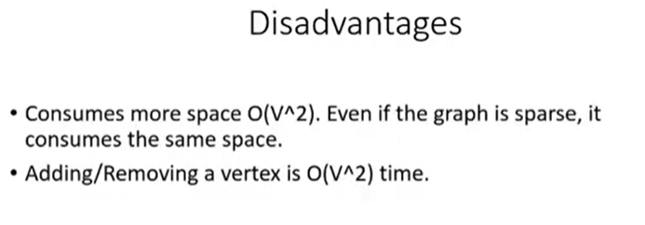
Advantages and Disadvantage
Software Design

Slide 52
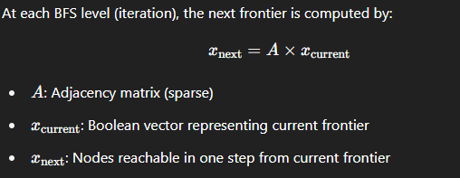
Matrix based BFS
Software Design
In matrix-based BFS, the graph is represented using an adjacency matrix AAA, and the BFS traversal is implemented as a series of matrix-vector multiplications. The BFS "frontier" (i.e., current level of nodes being visited) is stored as a vector x.

Slide 53
Matrix based BFS
Software Design
Graph Partitioning:
The adjacency matrix 𝐴A is divided row-wise or block-wise among different nodes.
Each processor stores only a portion of the matrix and the corresponding part of the frontier vector.
2. Parallel Matrix-Vector Multiplication:
Each processor performs local multiplication on its partition of the matrix and vector.
Results are communicated using MPI (Message Passing Interface) to form the global frontier vector.
Communication:
After each iteration, processors need to exchange parts of the updated vector to keep all copies consistent.
This is done using collective communication operations like MPI_Allgather.

Slide 54
CUDA programming
Software Design
Introduction to CUDA
CUDA (Compute Unified Device Architecture) is NVIDIA’s parallel computing platform.
Enables programming GPUs using familiar languages like C/C++.
Used for high-performance computing, machine learning, simulations, etc.

Slide 55
Memory Hierarchy in CUDA
Software Design
CUDA Memory Model Overview
Registers: Fastest, private to threads.
Shared Memory: Shared within a thread block.
Global Memory: Accessible by all threads, but slow.
Constant & Texture Memory: Specialized read-only caches.
Visual diagram of memory hierarchy (recommended).

Slide 56
What is Distributed Memory in CUDA?
Software Design
Distributed Shared Memory (DSM)
A new feature (Compute Capability 9.0+) enabling multiple thread blocks to access shared memory.
Shared memory spans across block clusters, not just inside one block.
Enables inter-block cooperation without global memory.

Slide 57
Why DSM is Important
Software Design
Why Use Distributed Shared Memory?
Avoids slow global memory for inter-block communication.
Speeds up reduction, histogram, and matrix operations.
Improves efficiency for problems requiring data exchange across thread blocks.

Slide 58
Thread Block Clusters
Software Design
Clusters and Cooperative Execution
Clusters = Groups of thread blocks.
Cluster-wide synchronization and memory mapping.
API support:
cooperative_groups::cluster_group
cluster.sync(), cluster.map_shared_rank()
Only available on Hopper architecture (H100, etc.)

Slide 59
Example Kernel (Histogram)
Software Design
Code Example Using DSM
extern __shared__ int dsm[];
auto cluster = cooperative_groups::this_cluster();
int* shared_bin = reinterpret_cast<int*>(cluster.map_shared_rank(0));
// Atomically increment the histogram bin
atomicAdd(&shared_bin[val], 1);
// Synchronize all blocks in the cluster
cluster.sync();

Slide 60
Performance Benefits
Software Design
Performance Gains of DSM
Content:
Reduced latency compared to global memory access.
Less reliance on atomic operations in global memory.
Higher throughput in tightly-coupled computations.
Graph comparing traditional vs DSM approach (optional).

Slide 61
Limitations and Requirements
Software Design
Limitations of DSM
Requires Hopper or newer GPUs (Compute Capability 9.0+).
DSM size is limited by total shared memory.
Complexity in synchronization and data mapping.
Only available in clustered kernel launches.

Slide 62
Learning Resources
Software Design
Further Reading
NVIDIA CUDA Programming Guide: docs.nvidia.com/cuda
CUDA Samples on GitHub
Book: “Programming Massively Parallel Processors” – Hwu
NVIDIA Developer Blog

Slide 63
Parallel matrix operations
Software Design
Introduction to Distributed Memory
Distributed memory = each processor has its own local memory
Message Passing Interface (MPI) used for communication
Suitable for large-scale matrix operations in HPC
Communication needed between processors for coordination
Visual: Image of distributed memory architecture (optional)

Slide 64
Why Parallel Matrix Operations?
Software Design
Solves large matrix problems faster
Reduces computational load on a single processor
Essential for scientific computing, simulations, ML
Makes efficient use of multi-node supercomputers

Slide 65
Matrix Partitioning Techniques
Software Design
Method | Description
Row-wise | Matrix split into horizontal slices
Column-wise | Matrix split into vertical slices
Block-wise | Matrix divided into square blocks
2D Block-Cyclic | Even load balancing across grid

Slide 66
Matrix Multiplication in Distributed Memory
Software Design
Example: C = A × B
Each node has:
Part of A (rows)
All or part of B (columns)
Nodes perform partial multiplication
Results are gathered to form final matrix C
Visual: Use the uploaded block matrix multiplication image here

Slide 67
Algorithms Used
Software Design
Algorithm | Key Features
Cannon’s Algorithm | 2D mesh/grid, efficient data reuse
Fox’s Algorithm | Uses broadcasting, better synchronization
SUMMA | Flexible, scalable for non-square grids

Slide 68
MPI-Based Matrix Multiplication Steps
Software Design
MPI_Scatter(...); // distribute matrix A
MPI_Bcast(...); // broadcast matrix B
local_C = multiply(...);
MPI_Gather(...); // collect result matrix C

Slide 69
Challenges in Distributed Matrix Ops
Software Design
Communication overhead
Load balancing between processors
Scalability for very large matrices
Synchronization delays

Slide 70
Libraries and Tools
Software Design
Library | Description
MPI | Communication standard
ScaLAPACK | Linear algebra in distributed systems
PETSc | Scientific computing toolkit
Trilinos | HPC matrix and solver framework

Slide 71
Real-world Applications
Software Design
Applications:
Weather forecasting
Medical image reconstruction
Machine Learning (e.g., matrix ops in training)
Finite Element Analysis (FEA)

Slide 72
Conclusion
Software Design
Parallel matrix operations enable solving massive matrix computations
Distributed memory provides scalability and performance
Efficient algorithms and communication are key to success

Slide 73
Sparse vs Dense matrices.
Software Design
Introduction to Matrices
A matrix is a 2D array of numbers.
Used in linear algebra, data science, image processing, machine learning, etc.
Based on element distribution, matrices can be:
Dense: Most elements are non-zero
Sparse: Most elements are zero.

Slide 74
What is a Dense Matrix?
Software Design
A matrix in which most of the elements are non-zero.
Example:
{1 2 3
4 5 6
7 8 9}
Points:
Regular format in most math problems.
Requires full memory for all elements.

Slide 75
What is a Sparse Matrix?
Software Design
A matrix in which most elements are zero.
Example:
{0 0 3
0 0 0
0 7 0}
Points:
Common in scientific computing and ML.
Stored using special formats to save space.

Slide 76
Key Differences (Tabular Comparison)
Software Design
Feature | Sparse Matrix | Dense Matrix
Zero Elements | Majority | Few
Storage | Compressed formats | Standard 2D arrays
Memory Use | Efficient | High
Computation | Optimized techniques | Standard computation
Applications | ML, Graphs, PDEs | General matrix ops

Slide 77
Insert Your Diagram
Software Design
Use the uploaded image to visually explain the difference.
Mention what each part of the image shows (e.g., non-zero pattern).
Add annotations if needed.
Title: Visual Representation: Sparse vs Dense

Slide 78
Storage Formats for Sparse Matrices
Software Design
Common Formats:
COO (Coordinate List)
CSR (Compressed Sparse Row)
CSC (Compressed Sparse Column)
DOK (Dictionary of Keys)
Visual Tip: Add a small matrix and how it is stored in CSR format.

Slide 79
Applications
Software Design
Area | Use of Sparse Matrices
Machine Learning | TF-IDF in NLP, recommender systems
Scientific Computing | Solving sparse systems of equations
Graph Theory | Adjacency matrices
Image Processing | Compressed representations

Slide 80
When to Use Sparse vs Dense
Software Design
Use Sparse:
70% of elements are zero
Memory or storage constraints
Iterative methods are used
Use Dense:
Few zero elements
Simpler algorithms
When computation speed is prioritized over memory

Slide 81
Daily Quiz
Daily Quiz
Which of the following is true about distributed memory systems? A) All processors share the same physical memory. B) Communication happens through shared variables. C) Each processor has its own local memory. D) They are best suited for SIMD architectures.
In MPI (Message Passing Interface), which operation is used to send data from one process to all other processes? A) Scatter B) Gather C) Broadcast D) Reduction
What is the purpose of the 'Reduction' operation in parallel programming? A) Compressing data into a smaller array B) Sending the same data to all nodes C) Combining values from multiple processes using an operation like sum or max D) Eliminating duplicate processes
Which operation collects elements from all processes and assembles them at the root process? A) Scatter B) Gather C) All-to-all D) Broadcast
Which of the following best describes a “Parallel Prefix Sum” operation? A) Finding maximum from all elements B) Calculating cumulative sum in parallel C) Rearranging array elements in parallel D) Splitting array into equal parts

Slide 82
Daily Quiz
Daily Quiz
6. Which topology provides the shortest average communication distance in large systems? A) Ring B) Mesh C) Hypercube D) Star
7. In a distributed BFS algorithm using an adjacency matrix, what is the time complexity for visiting all vertices (V) and edges (E)? A) O(V + E) B) O(V²) C) O(E log V) D) O(V log E)
8. In CUDA programming, threads are grouped into: A) Kernels B) Blocks C) Processes D) Warps
9. Which matrix type is most efficient for representing graphs with a small number of edges relative to vertices? A) Dense matrix B) Sparse matrix C) Diagonal matrix D) Identity matrix

Slide 83
Weekly Assignment
Weekly Assignment
Explain with diagrams: Difference between shared memory and distributed memory systems.
Draw and explain ring, mesh, torus, and hypercube topologies.
Analyze latency and bandwidth trade-offs for each topology.
Implement matrix-based BFS using sparse matrix-vector multiplication.
Extend one CUDA kernel to perform sparse matrix multiplication.
Compare CPU vs GPU performance for different matrix sizes.
Compare performance with adjacency list-based BFS.
Explain memory and computation advantages of sparse vs dense matrices.

Slide 84
Expected Questions for University Exam
Expected Questions for University Exam
What is a distributed memory architecture, and how does it differ from shared memory?
Explain the working principle of a message passing network.
Explain the Broadcast operation in MPI with a suitable example.
What is Reduction in parallel computing? Mention use cases with sum, max, and min.
Explain mesh, ring, and hypercube topologies with diagrams.

Slide 85
Recap
Summary
Distributed Memory & Message Passing Networks
Broadcast, Reduction, Prefix Sum
Scatter and Gather
Network Topologies for Parallel Computing-Ring, Mesh, Torus, Hypercube, Star, Tree: Different ways to interconnect processors.
Network Optimization
Distributed BFS (Breadth-First Search)
Graphs and Adjacency Matrix
Matrix-Based BFS
CUDA Programming
CUDA: NVIDIA’s platform for GPU programming.
Parallel Matrix Operations

Slide 86
References
References
Thomas Sterling, Matthew Anderson, and Maciej Brodowicz, High Performance Computing: Modern Systems and Practices, Morgan Kaufmann, 2018.
Barbara Chapman, Gabriele Jost, and Ruud van der Pas, Using OpenMP: Portable Shared Memory Parallel Programming, The MIT Press, 2007.
Ananth Grama, Anshul Gupta, George Karypis, and Vipin Kumar, Introduction to Parallel Computing, 2nd Edition, Addison-Wesley, 2003.
Tim Mattson et al., The OpenMP Common Core: A Hands-on Exploration, The MIT Press, 2019.
Tim Mattson and Larry Meadows, A Hands-on Introduction to OpenMP, 1st Edition, The MIT Press, 2016.
Ruud van der Pas, OpenMP Tasking Explained, Springer, 2021.Peter Pacheco, An Introduction to Parallel Programming, 1st Edition, Morgan Kaufmann, 2011.

Slide 87
THANK YOU

Slide 88
Faculty Video Links, Youtube & NPTEL Video Links and Online Courses Details
Unit 1 | https://youtu.be/HNF7m0TBWec?si=cBh22c11c583Ecf8
Unit 2 | https://www.youtube.com/watch?v=FTXikoQr46U
Unit 3 | https://www.youtube.com/watch?v=gE8KgD9D69k
Unit 4 | https://www.youtube.com/watch?v=kHV6wmG35po
Unit 5 | https://www.youtube.com/watch?v=JeuP0oMQ8sQ

